Slide 1
Machine learning on cell image analysis
Seonghoo Kim
August 5, 2021

Slide 2
Cell image analysis
SKOPY
Image analysis application from Broad Institute
Lightweight version of Cell Profiler
Total of 255 features extracted from SKOPY
Running machine learning on these data for outliers and prediction
Database integration

Slide 3


Resources used
Hypi
Low-code platform for apps
GraphQL
Optimized for a specific endpoint vs REST (better for deploying)
Two separate apps
Storing data from SKOPY
Storing data for outliers and predicted data
Apache Ignite
Distributed database for computing
Integrated machine learning algorithm

Slide 4
K-means
A machine learning algorithm that partitions data into k groups
Using data from SKOPY, create the same number of clusters as number of images
Find outliers, return the data to user as well as insert into database

Slide 5
Random Forest
A machine learning algorithm that constructs a chain of decision trees
Configured based on efficiency and accuracy
Get trained model, put into database as well as return to use

Slide 6
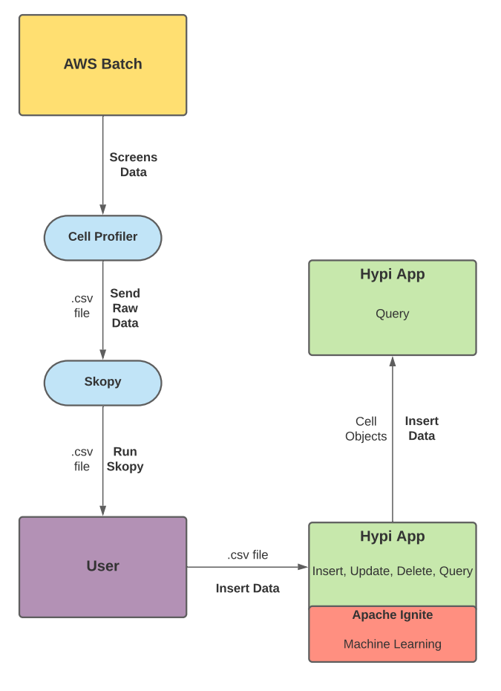
Flow Model
Regarding data stream, currently no real data due to complications with partnering teams

Slide 7
Future Improvements
More machine learning capabilities
Visual components
User-friendly

